Slide 1
Chain size
Next element
Algorithm:
1. Extend each key to a tripple ( - , key, - )
2. For all tripples t = ( - , k, -), starting at rightmost position and working forward to the left, do:
2a) Find the tripple on right side of t, that has the smallest key greater than k. Let this element be
(m, y , n) .
2b) Change t to ( m + 1, k, y )
3. A longest chain (there can be several of such longest chains) starts with the tripple with the maximal first component (maximal chain size).

Slide 2
-
-
-
-
-
-
-
-
0
Max Chain size
67
75
69
70
22
71
24
25
26
Key Value
-
-
-
-
-
-
-
-
-
Next Element
-
-
-
-
-
-
-
1
0
Max Chain size
67
75
69
70
22
71
24
25
26
Key Value
-
-
-
-
-
-
-
26
-
Next Element
-
-
-
-
-
-
2
1
0
Max Chain size
67
75
69
70
22
71
24
25
26
Key Value
-
-
-
-
-
-
25
26
-
Next Element

Slide 3
-
-
-
-
-
-
-
-
0
Max Chain size
67
75
69
70
22
71
24
25
26
Key Value
-
-
-
-
-
-
-
-
-
Next Element
-
-
-
-
-
-
-
1
0
Max Chain size
67
75
69
70
22
71
24
25
26
Key Value
-
-
-
-
-
-
-
26
-
Next Element
-
-
-
-
-
-
2
1
0
Max Chain size
67
75
69
70
22
71
24
25
26
Key Value
-
-
-
-
-
-
25
26
-
Next Element

Slide 4
-
-
-
-
-
0
2
1
0
Max Chain size
67
75
69
70
22
71
24
25
26
Key Value
-
-
-
-
-
-
25
26
-
Next Element
-
-
-
-
3
0
2
1
0
Max Chain size
67
75
69
70
22
71
24
25
26
Key Value
-
-
-
-
24
-
25
26
-
Next Element
-
-
-
1
3
0
2
1
0
Max Chain size
67
75
69
70
22
71
24
25
26
Key Value
-
-
-
71
24
-
25
26
-
Next Element

Slide 5
-
-
2
1
3
0
2
1
0
Max Chain size
67
75
69
70
22
71
24
25
26
Key Value
-
-
70
71
24
-
25
26
-
Next Element
-
0
2
1
3
0
2
1
0
Max Chain size
67
75
69
70
22
71
24
25
26
Key Value
-
-
70
71
24
-
25
26
-
Next Element
3
0
2
1
3
0
2
1
0
Max Chain size
67
75
69
70
22
71
24
25
26
Key Value
69
-
70
71
24
-
25
26
-
Next Element

Slide 6
3
0
2
1
3
0
2
1
0
67
75
69
70
22
71
24
25
26
69
-
70
71
24
-
25
26
-
67
22
69
24
70
25
71
25

Slide 7
Optimization
Limit the search space when finding the smallest element larger by keeping a list of “best candidates”

Slide 8
-
-
-
-
-
-
-
-
0
Max Chain size
67
75
69
70
22
71
24
25
26
Key Value
-
-
-
-
-
-
-
-
-
Next Element
-
-
-
-
-
-
-
1
0
Max Chain size
67
75
69
70
22
71
24
25
26
Key Value
-
-
-
-
-
-
-
26
-
Next Element
-
-
-
-
-
-
2
1
0
Max Chain size
67
75
69
70
22
71
24
25
26
Key Value
-
-
-
-
-
-
25
26
-
Next Element

Slide 9
26 does not deserve any further consideration, because 71 is the better start of an empty chain!
-
-
-
-
-
0
2
1
0
Max Chain size
67
75
69
70
22
71
24
25
26
Key Value
-
-
-
-
-
-
25
26
-
Next Element
-
-
-
-
3
0
2
1
0
Max Chain size
67
75
69
70
22
71
24
25
26
Key Value
-
-
-
-
24
-
25
26
-
Next Element
-
-
-
1
3
0
2
1
0
Max Chain size
67
75
69
70
22
71
24
25
26
Key Value
-
-
-
71
24
-
25
26
-
Next Element

Slide 10
-
-
2
1
3
0
2
1
0
Max Chain size
67
75
69
70
22
71
24
25
26
Key Value
-
-
70
71
24
-
25
26
-
Next Element
-
0
2
1
3
0
2
1
0
Max Chain size
67
75
69
70
22
71
24
25
26
Key Value
-
-
70
71
24
-
25
26
-
Next Element
3
0
2
1
3
0
2
1
0
Max Chain size
67
75
69
70
22
71
24
25
26
Key Value
69
-
70
71
24
-
25
26
-
Next Element

Slide 11
3
0
2
1
3
0
2
1
0
67
75
69
70
22
71
24
25
26
69
-
70
71
24
-
25
26
-
67
22
69
24
70
25
71
25

Slide 12
Longest chains …
12
9
9
7
11
32
12
8
4 Chains with 13 elements:
10
34
20
9
35
27
8
37
28
7
41
39
6
64
55
5
66
4
72
3
73
2
77
1
83
0
84

Slide 13
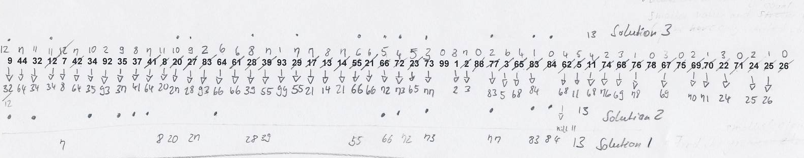
Paperwork …

